Slide 1
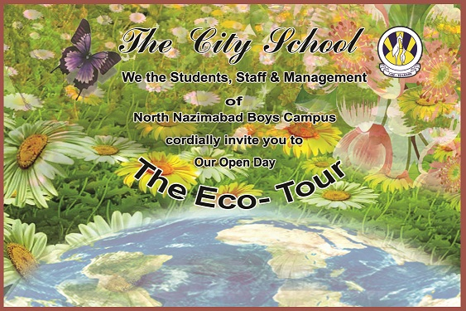
THE ECO-TOUR

Slide 2
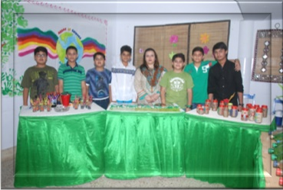
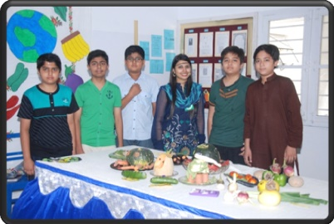
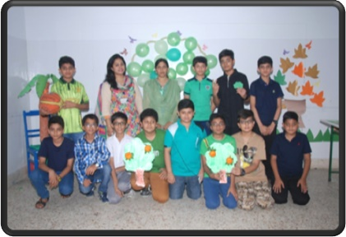
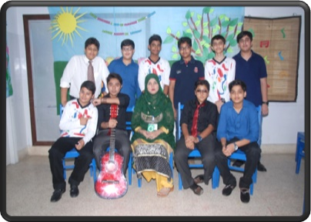
THE ECO-TOUR
SOUVENIR SHOP
A GLIMPSE OF SPRING
MIME – SAVE TREES
NATURE AND MUSIC

Slide 3
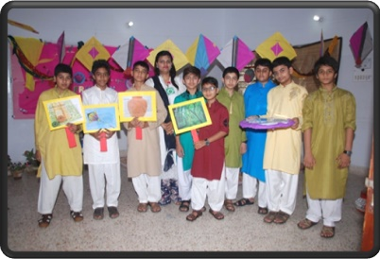
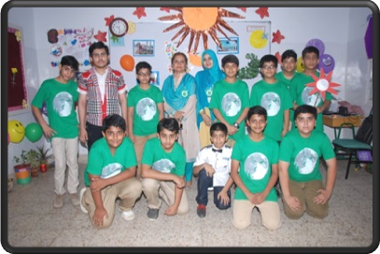
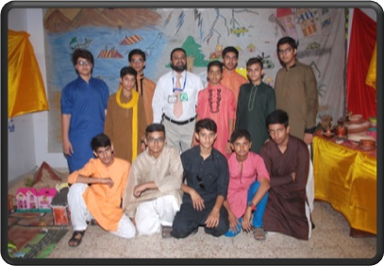
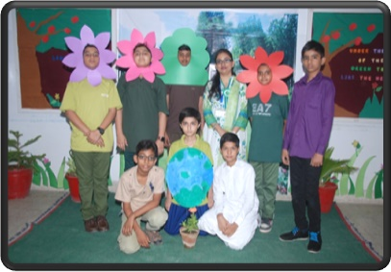
THE ECO-TOUR
SAY HELLO TO SPRING
TABLEAU
ARRAY OF SPRING
PROMOTE PLANTATION

Slide 4
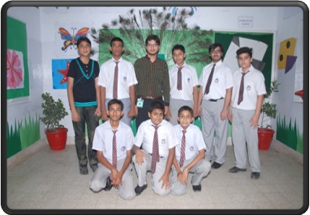
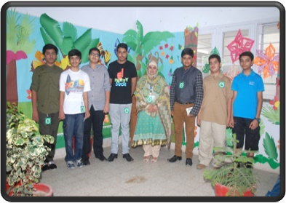
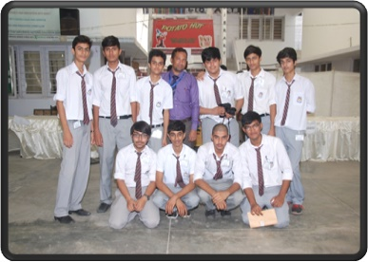
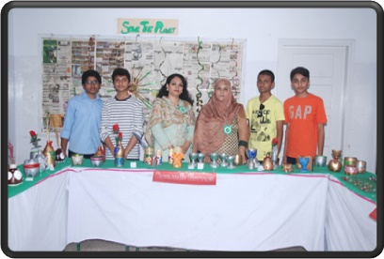
THE ECO-TOUR
GO GREEN-RUMBLE IN JUNGLE
SYMMETRY IN NATURE
FOOD COURT
3R TECHNIQUE

Slide 5
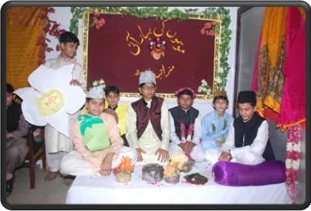
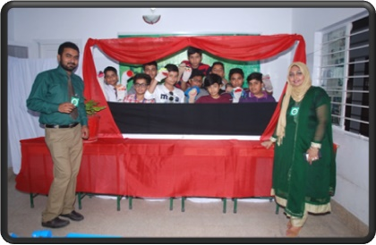
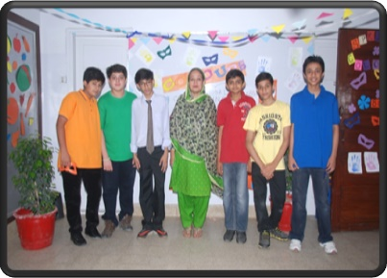
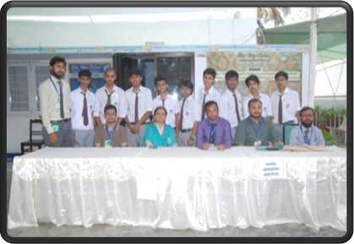
THE ECO-TOUR
FESTIVITIES OF SEASONS
PUPPET SHOW
SPRING COLOURS AND GLOBAL WARMING
FOOD COURT

Slide 6
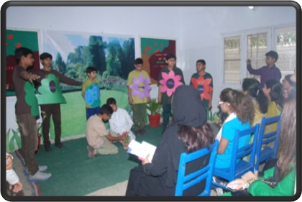
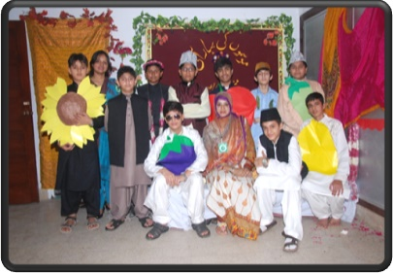
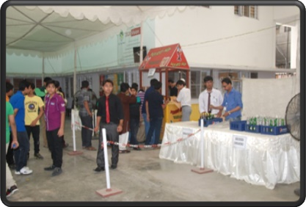
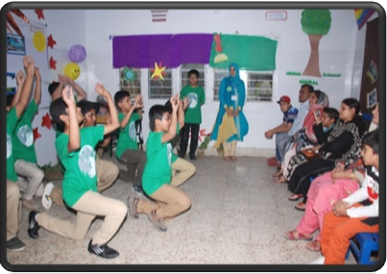
THE ECO-TOUR
PROMOTE PLANTATION
FESTIVITIES OF SEASONS
STALLS
PERFORMANCE

Slide 7
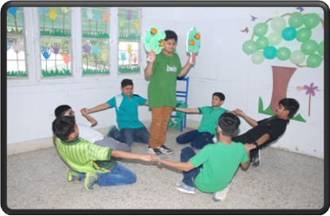
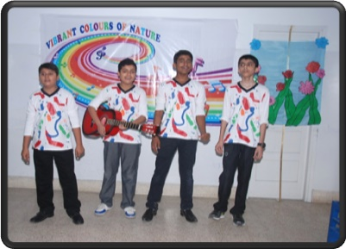
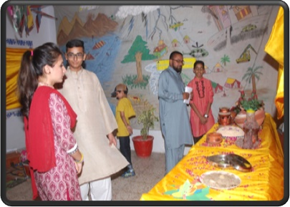
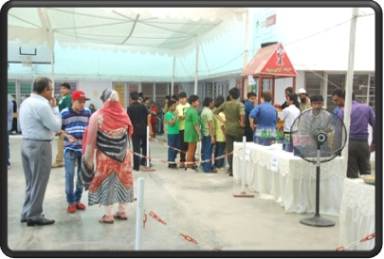
THE ECO-TOUR
PERFORMERS
VISITORS

Slide 8
THE ECO-TOUR
THANK YOU

